Slide 1

We4Authors Cluster Final Review
Notes:
SUSANNA

Slide 2
Agenda
13.00 – 13.15 Tour de table 13.15 – 13.45 WP3 Test implementation and result of discussions with market players 13.45 – 14.15 WP1 & WP3 Final Features, Repository and (D1.3) Technical specifications 14.15 – 14.30 Coffee break 14.30 – 15.00 WP4 Dissemination activities 15.00 – 15.15 WP5 Sustainability 15.15 – 15.30 Effort and resources spent 15.30 - 16.00 Internal meeting EC + experts 16.00 – 16.30 Initial feedback
Q&A included in each presentation
Notes:
SUSANNA

Slide 3
Participants from the Cluster:
Susanna Laurin (Funka)
Johan Kling (Funka)
Ewa Björk (Funka)
Timo Stollenwerk (Kitkoncept)
Mike Gifford (CivicActions)
Anders Korsvall (SiteVision)
Danny Lancaster (Nexer)
Kath Rickards (Nexer)
Hilary Stephenson (Nexer)
Rachel Breeze (Nexer)
Fredrik Danielsson (Tiny)
Notes:
ALL PARTICIPANTS
Presentation in order of the slide:
The presentation is one sentence only. Please state your name, title/role, organisation, what authoring tool you are representing in the project and where you are based geographically.

Slide 4

WP3: Test implementation and result of discussions with market players
Notes:
SUSANNA

Slide 5

Objective:
to carry out a validation of each chosen accessibility feature consisting of test-implementation in different technical environments to make sure the features can be widely used cross markets, ensuring flexibility and potential for wide-spread and vendor neutral use.
Notes:
SUSANNA

Slide 6
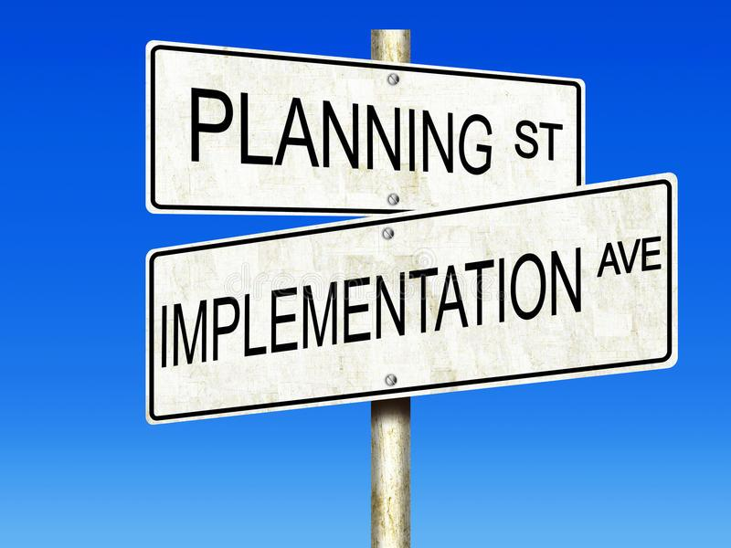

Tasks:
Test implementation of accessibility features
Repository of accessibility features
Notes:
SUSANNA

Slide 7

Deliverables:
D3.1 Report on the results of the test-implementation of accessibility features in different CMS
D3.2 Report on high-level discussions with We4Authors Cluster members and other relevant market players
D3.3 Report on the repository of accessibility features: structure and contents
Notes:
SUSANNA

Slide 8

Task 3.1 Test implementation of accessibility features
Implementation
Process
Current status
Potential impact
Notes:
SUSANNA

Slide 9
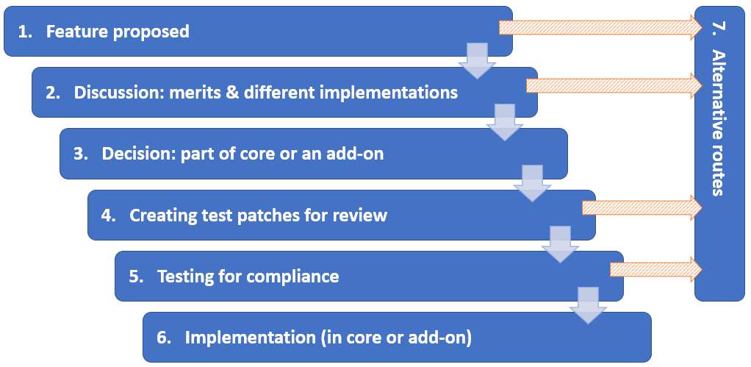
Process
Notes:
SUSANNA: Intro, tools do this in different ways but it is still useful to do a schematic overview.
MIKE walks through the different steps as described in D3.2 page 5-8. Each step for children, please ☺
ANDERS to add some comments on parts where the licensed product process differs from the open source one.

Slide 10
Timo to add screenshot from GitHub/Plone community
Notes:
TIMO: to describe how discussions can happen and add one short example of something that possibly be challenging, stopping or delaying a feature to be implemented.

Slide 11
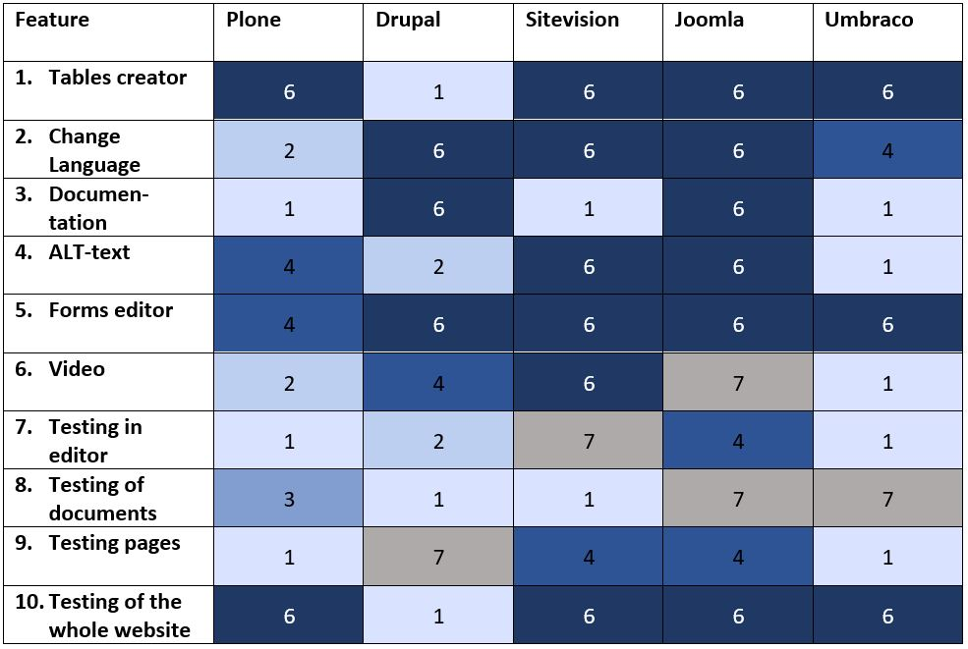
Current status
Notes:
SUSANNA describes the table and what it means
MIKE: for example the ML piece, describe the challenges that makes it difficult to implement …
TIMO: and/or third party elements like the Forms editor …
ANDERS: short comment on the status of the current status of SV implementation

Slide 12
Examples
ALL PARTNERS to add screenshots of implementations!
Notes:
TIMO: here we see ….

Slide 13
Potential impact (illustration to be updated by Peter)
 | Relevant for a large group of end users | Relevant for a small group of end users
High implementation potential | Tables creator, Forms editor | Change language
Lower or Medium implementation potential | Video | ALT-text
Notes:
SUSANNA: explain the table and the market potential, what we expect to see in the near future
FREDRIK: Something like: “On the editor side, we see a clear demand for built-in features like these, so I expect us to further develop these or similar features into our standard products …” (say something that is true ☺)
MIKE: Before the Cluster project, only demand could drive this development. But now, because of this remarkable project, we can show best practice which makes it easier to implement and foster competition and innovation …

Slide 14

Task 3.1 High-level discussions with other market players
Learn about possible barriers
Get feedback from market players
Raise awareness
Showcase the potential
Notes:
SUSANNA

Slide 15
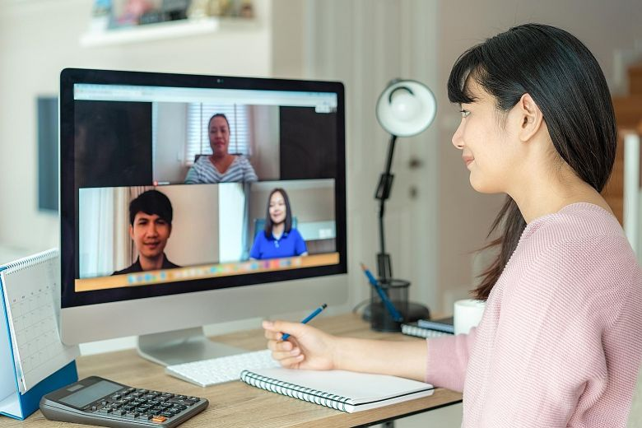
Specific market outreach
Validation of prototypes
Targeted surveys
Semi-structured interviews
Bilateral meetings
Notes:
SUSANNA: intro, this is how we carried out the task …
TIMO to chime in briefly in Germany for example, the CMS Garden has been very supportive of the project, providing the opportunity to align with other players …

Slide 16

A diverse industry
Authoring tools producers and providers
ICT-suppliers
Open source and licensed tools
Headless, decoupled and monolithic tools
Small and large market players
From across the EU and beyond
Notes:
SUSANNA: we have tried to reach as widely as possible …
MIKE to chime in briefly: the high level of interest has been very encouraging, for example, I spoke briefly to (someone) who said (something positive)

Slide 17

Demand and interest
Overwhelmingly positive
Market cooperation
Best practice
More features to be developed
Wider uptake of features (beyond CMS)
Notes:
SUSANNA

Slide 18

Q&A

Slide 19

Task 3.2: Repository of accessibility features
Notes:
SUSANNA

Slide 20

Repository
User needs
Selection criteria
User testing
Presentation of each feature
Technical specifications
Information for developers
Mapping of user requirements with accessibility features
Matrix of user testing/relevance/ease of use/editor accessibility
Notes:
SUSANNA: describing the set-up
TIMO chiming in: these parts (pick some) are especially important/relevant for market players outside of the Cluster to be able to implement the features

Slide 21
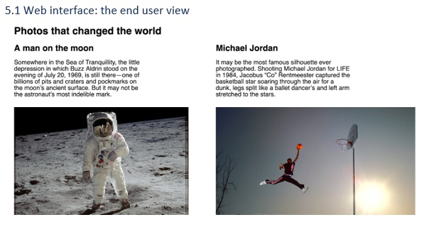
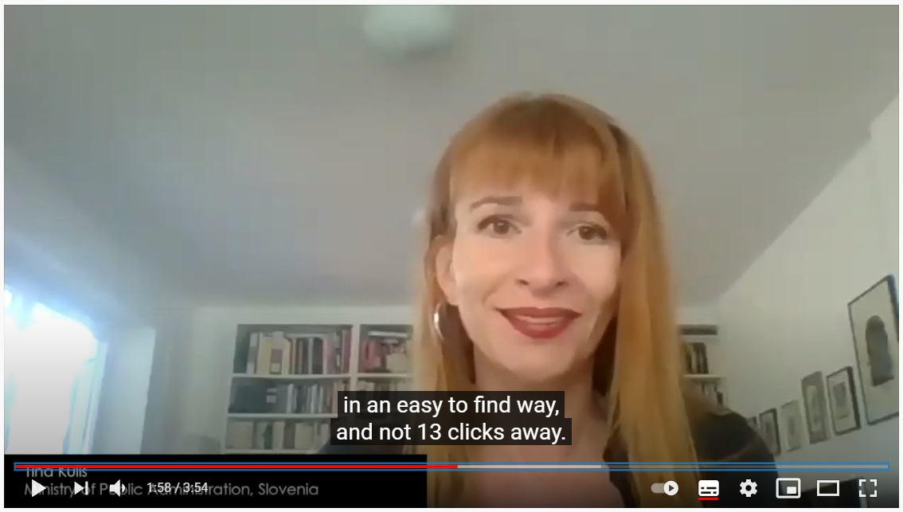
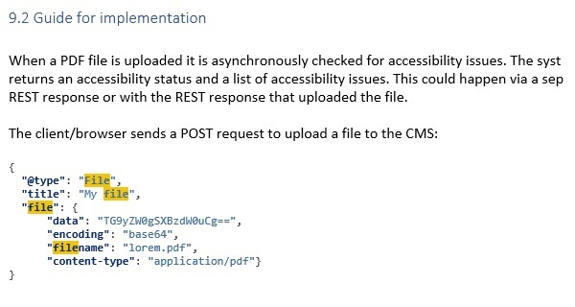
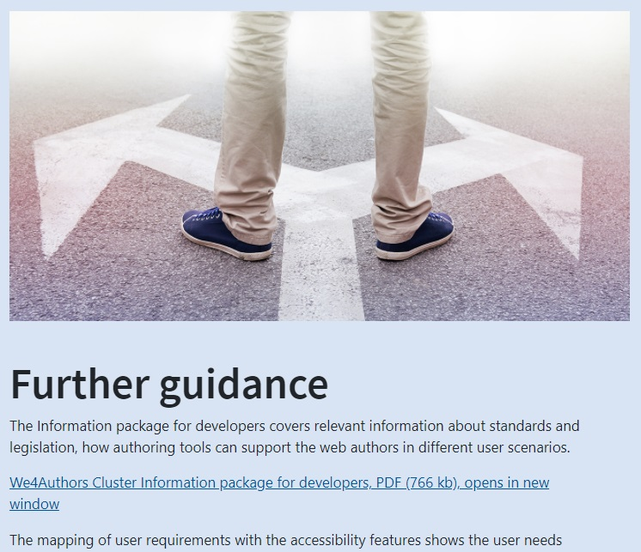
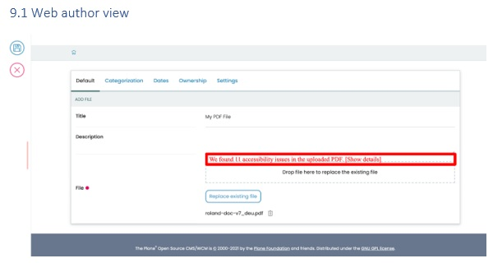
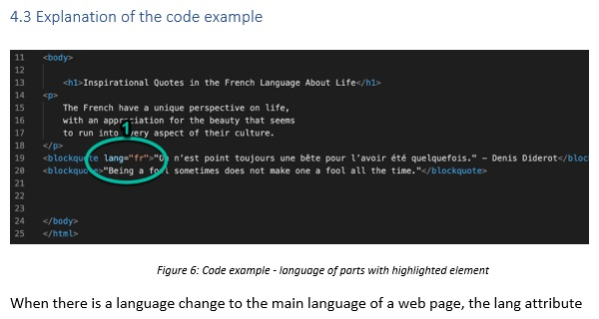
..
Notes:
SUSANNA

Slide 22
Presentation of features
the problem from the perspective of the end user (where relevant),
the challenge from the perspective of the web author,
the solution developed by the consortium,
the key code of each feature,
the result for the end user when the feature is used (where relevant).
Notes:
SUSANNA
NEXER: to show the end user perspective is especially important as many – both on demand and supply-side – are still not aware. Like the Change language feature, we know that … (or another example)

Slide 23
DEMO
Notes:
SUSANNA One of the videos being played

Slide 24
Q&A

Slide 25


Slide 26
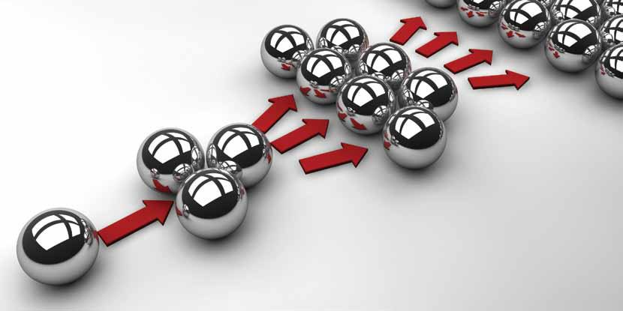
WP4: Dissemination
Notes:
Ewa

Slide 27

Objective:
Contributing to a wider take-up of built-in accessibility in authoring tools, as a way to incentivise competition in the area and raise overall awareness of its benefits for the whole market.
Notes:
Ewa

Slide 28
Tasks:
Notes:
Ewa

Slide 29
Deliverables:
Notes:
Ewa

Slide 30

Target groups
Authoring Tool Producers
ICT Suppliers
Public Sector’s web authors
End-users with disabilities
Notes:
Ewa

Slide 31
Outreach
Webinars & Events
Twitter
Newsletters & blogs
Project website
Facebook & LinkedIn
Developers channels
Notes:
Ewa

Slide 32
Webinars and events
Notes:
Ewa

Slide 33
Twitter activities
Notes:
Ewa

Slide 34
Newsletters & Blogs
Notes:
Ewa

Slide 35
Project website
Information about the project
News
Project result
Outreach activities
Notes:
Ewa

Slide 36
Facebook & LinkedIn
Notes:
Ewa

Slide 37
Key Performance Indicators
Notes:
Ewa

Slide 38

Conclusion
Dissemination success
Based on fruitful collaboration
Notes:
Ewa

Slide 39
Q&A

Slide 40

WP5: Project management and sustainability plan
Notes:
SUSANNA

Slide 41

Objective:
to manage and effectively monitor the project, in administrative, technical and financial terms. Set up processes to ensure smooth operation and proper implementation of the Grant Agreement. Reporting, risk management, quality assurance, performance planning and progress control.
Notes:
SUSANNA

Slide 42
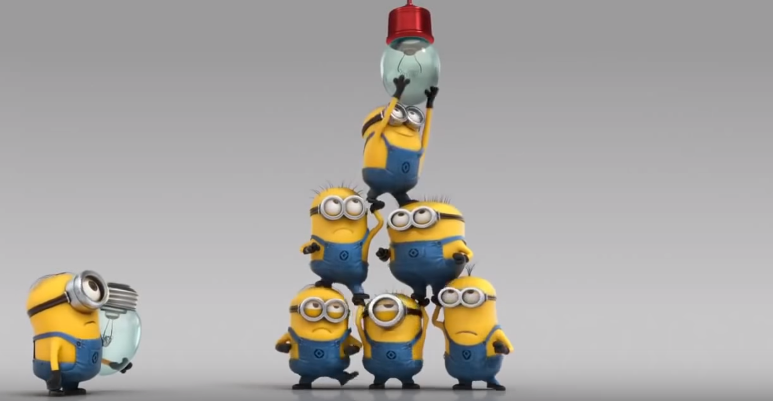
Tasks:
Project management plan
Sustainability plan
Operations and financial management
Notes:
SUSANNA

Slide 43
Deliverables:
D5.1 Project management plan (M3)
D5.2 Sustainability plan (M16)
D5.3 First progress report (M6)
D5.4 Second progress report (M12)
D5.5 Final report (M18)
Notes:
SUSANNA

Slide 44

Sustainability
Notes:
SUSANNA

Slide 45

The prerequisites
Collaborative knowledge cluster
Key market players
Agreed accessibility features
Show best practice
Stimulate the market
Healthy co-operation and/or competition
Notes:
SUSANNA

Slide 46

Cluster members’ commitments
Reporting on changes/requests for updates
Features presentation
Technical specifications
Project website/repository
Cluster members collaboration model
Future projects
Notes:
SUSANNA

Slide 47

Continued Cluster collaboration
Creating more features
Stimulate demand among procurers
Including web authors in the Cluster
Built-in accessibility features in editors
Built-in accessibility for web authors with disabilities
Built-in document testing
Notes:
SUSANNA makes the introduction and walks through the project ideas
MIKE says something about the potential and how important another project would be …

Slide 48

Potential Cluster expansion
Content Management Systems
Craft
Ghost
Learning Management Systems
Editors
CKEditor
Notes:
SUSANNA makes the introduction
FREDRIK says something about authoring tools being so much broader than only CMS, for example …

Slide 49
Q&A

Slide 50

Effort and resources spent
Notes:
SUSANNA

Slide 51
Reported effort versus planned effort
Notes:
SUSANNA

Slide 52
Resources consumed
Notes:
SUSANNA

Slide 53
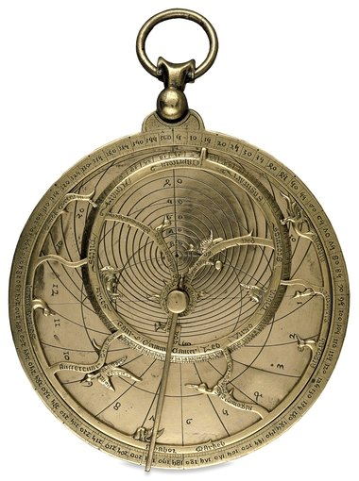
Deviations from the estimated budget
Notes:
SUSANNA

Slide 54
Budget implementation
Notes:
SUSANNA

Slide 55
Q&A

Slide 56
Thank you for listening!

